Slide 1
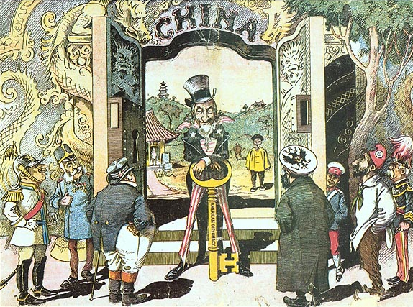
What is a symbol?
What countries do the people represent? How do you know?
Why is Uncle Sam bigger than the other people?
What does this say about American Imperialism?
Caption: The Open Door to China! Uncle Sam has distanced all competitors in gaining access to the flowery kingdom!”
Key says “American Diplomacy”

